Slide 1
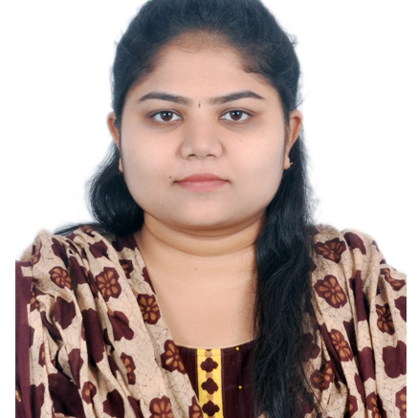


G GOWRIPRIYA
Analyst/Software Engineer
BACHELOR OF TECHNOLOGY
Electronics and communication Engineering:2017-2021
Skills C#
Dot net core
Java core
C language
Manual testing
Advance Excel
DatabaseL
MS SQL Server 2014
SQL core
Web Technologies
HTML5
CSS3
AddOns
Github
Postman
Additional skills
Leadership Qualities
Quick Learner
Team Management
Good communication
BANGALORE
gowripriya.g@capgemini.com
+91 8374336993
A4
Well versed with the functional knowledge of SDLC stages ranging from Requirement Gathering to Analysis, Design, Development, Testing, Deployment and Documentation
Reliable, dedicated and efficient team player and able to adopt the process changes effectively
Ability and flexibility to multi-task, prioritize, and organize multiple projects/ tasks concurrently while meeting project deadlines
Have better understanding on process agility and can come to up to speed on new technologies/ methodologies in best possible way
Able to deliver with zero defects products to customer with good development skills and interact with client with excellent communication skills
Movie Management System :
Completed end to end case study of Movie management System along with JWT authentication, Swagger. html, CSS, JSused for user interface.
Microsoft Azure Fundementals Certificate
Microsoft Azure Developer Associate
Project:
I have completed Robohelp and spendsmart task as dev in the GAM team at MCD project.
Check out my work on GitHub & Video Profile

